Slide 1
Credit Rating Failures in the Aftermath of the Mortgage Meltdown
Mark Adelson
Independent Consultant
Editor, Journal of Structured Finance
Americans for Financial Reform—FinReg Group January 12, 2022

Slide 2
What Do These Movies Have in Common?
Citizen Kane
Fight Club
Pulp Fiction
Forrest Gump

Slide 3
RMBS 10-Year Rate of Defaults (as of December 31, 2017)
 | Moody's | S&P | Fitch
Aaa/ AAA | 30% | 31% | 35%
Aa/AA | 56% | 53% | 38%
A/A | 57% | 66% | 50%
Baa/BBB | 71% | 75% | 62%
Ba/BB | 81% | 85% | 75%
B/B | 89% | 93% | 84%

Slide 4
U.S. MBS Issuance and Loan Originations ($ trillions)
Housing Bubble Starts
Mortgage Meltdown Starts
Financial Crisis Starts
Dodd-Frank Act
Source: SIFMA, Inside Mortgage Finance

Slide 5
2010 Three-way Stand-off: SEC vs. Rating Agencies vs. Issuers
1981: Proposal. Disclosure of Securities Ratings in Registration Statements, Rel. Nos. 33-6336, 34-18012, 46 Fed. Reg. 42024 (18 Aug. 1981)
1982: Ratings not considered part of a registration statement, which would otherwise trigger potential liability. SEC Rule 436(g), 17 C.F.R. § 230.436(g); Adoption of Integrated Disclosure System, Rel. Nos. 3-6383, 34-18524, 47 Fed. Reg. 11380, 11441 (16 Mar. 1982)
2010: Dodd-Frank Act § 939G nullifies Rule 436(g), intending to impose liability on rating agencies by requiring consent to liability
2010: Rating agencies refuse to provide consents
2010: SEC no-action letter re Ford Motor Credit dodges DFA § 939G by allowing issuers to omit ratings from prospectuses

Slide 6
Mortgage Meltdown — The Aftermath
$1 trillion (±20%) of losses on mortgage loans from 2007 through roughly 2016
Industry-wide breakdown of loan origination and securitization practices
Loans did not conform to the descriptions in the securities offering materials or comply with contractual representations and warranties
Huge failure of investor protection because of short limitations periods
Servicing violations
Investors and the government have recovered less than 25%
Horrible performance of credit ratings

Slide 7
How Do We Know What Happened & Why?
Early reports did not cover the full magnitude of the wrongdoing
FCIC (2009) and U.S. Senate (2011)
DOJ investigations/settlements found much more (2013-2019)
FHFA v. Nomura trial and decision (2015)
Trials in private cases (Assured 2013 and MBIA 2020)
Rating agency cases
U.S.: S&P (2015), Moody’s (2017), & SEC enforcement
Australia: S&P (2018), Fitch (2019)

Slide 8
Selected Settlements of DOJ MBS Cases ($ billions)
Date | Total Amount | Cash Penalty | Consumer Relief | Defendant | Plaintiff(s) | Admissions
11/19/2013 | 13.0 | 9.0 | 4.0 | JP Morgan Chase | DOJ + states¹ | ✓
7/14/2014 | 7.0 | 4.5 | 2.5 | Citigroup | DOJ + states | ✓
8/21/2014 | 16.65 | 9.65 | 7.0 | Bank of America | DOJ + states | ✓
2/25/2015 | 2.6 | 2.6 | 0 | Morgan Stanley | DOJ | ✓
2/11/2016 | 3.173 | 2.773 | 0.4 | Morgan Stanley | DOJ + states² | ✓
4/11/2016 | 5.06 | 3.26 | 1.8 | Goldman Sachs | DOJ + states | ✓
1/17/2017 | 7.2 | 3.1 | 4.1 | Deutsche Bank | DOJ | ✓
1/18/2017 | 5.28 | 2.48 | 2.8 | Credit Suisse | DOJ | ✓
3/29/2018 | 2.0 | 2.0 | 0 | Barclays | DOJ | ✗
8/1/2018 | 2.09 | 2.09 | 0 | Wells Fargo | DOJ | ✗³
8/14/2018 | 4.9 | 4.9 | 0 | Royal Bank of Scotland | DOJ | ✗³
10/9/2018 | 0.765 | 0.765 | 0 | HSBC | DOJ | ✗
10/16/2018 | 0.48 | 0.48 | 0 | Nomura | DOJ | ✗³
4/12/2019 | 1.5 | 1.5 | 0 | General Electric | DOJ | ✗
¹ Includes $4 billion of a previously announced settlement with the FHFA. ² Reported as $3.2 billion but includes $2.6 billion of a previously announced settlement with DOJ. ³ Settlement details DOJ’s findings but defendant did not admit to them.

Slide 9
Selected Settlements of FHFA & GSE MBS Cases ($ millions)
Date | Amount | Defendant | Plaintiff | Date | Amount | Defendant | Plaintiff
12/31/2010 | 1,520 | Bank of America | Fannie | 2/27/2014 | 122 | Société Générale | FHFA
12/31/2010 | 1,350 | Bank of America | Freddie | 3/21/2014 | 885 | Credit Suisse | FHFA
5/28/2013 | 250 | Citigroup | FHFA | 3/26/2014 | 9,300 | Bank of America, Countrywide, and Merrill Lynch | FHFA
7/25/2013 | 885 | UBS | FHFA
10/25/2013 | 5,100 | JP Morgan Chase | FHFA | 4/24/2014 | 280 | Barclays | FHFA
11/6/2013 | 335 | Wells Fargo | FHFA | 4/29/2014 | 110 | First Horizon | FHFA
12/2/2013 | 404 | Bank of America | Freddie | 6/19/2014 | 100 | RBS | FHFA
12/20/2013 | 1,925 | Deutsche Bank | FHFA | 8/22/2014 | 3,150 | Goldman Sachs | FHFA
12/31/2013 | 475 | Ally Financial | FHFA | 9/12/2014 | 550 | HSBC | FHFA
1/7/2014 | 10,300 | Bank of America | Fannie | 7/12/2017 | 5,500 | RBS | FHFA
2/7/2014 | 1,250 | Morgan Stanley | FHFA | 6/25/2018 | 847 | Nomura | FHFA*
* Case was tried and affirmed on appeal. Federal Housing Finance Agency v. Nomura Holdings America, 104 F. Supp. 3d 441 (S.D.N.Y. 2015), aff’d. 873 F.3d 85 (2d Cir. 2017), cert. denied 585 U.S. ___ (No. 17 1302, 25 Jun 2018). Note: Links to the complaints in the FHFA cases are available at https://www.fhfa.gov/SupervisionRegulation/LegalDocuments/Pages/Litigation.aspx and a list of the FHFA settlements appears at https://www.fhfa.gov/Media/PublicAffairs/Pages/FHFA-Final-Update-on-Private-Label-Securities-Actions-9172018.aspx.

Slide 10
Rating Agency Litigation
S&P 2015 settlement: $1.375 billion
Moody’s 2017 settlement: $864 million
S&P 2018 Australian settlement: A$215 million
Fitch 2019 Australian settlement: A$27 million
But Nobody Went to Jail.

Slide 11
Moody’s “Idealized” Default Rates
Years | Aaa | Aa | A | Baa | Ba | B
1 | 0.0% | 0.0% | 0.0% | 0.2% | 1.6% | 7.2%
2 | 0.0% | 0.0% | 0.1% | 0.5% | 3.5% | 11.7%
3 | 0.0% | 0.0% | 0.2% | 0.8% | 5.2% | 15.6%
4 | 0.0% | 0.0% | 0.3% | 1.2% | 6.8% | 18.1%
5 | 0.0% | 0.1% | 0.5% | 1.6% | 8.4% | 20.7%
6 | 0.0% | 0.1% | 0.6% | 2.0% | 9.8% | 22.7%
7 | 0.0% | 0.1% | 0.7% | 2.4% | 10.7% | 24.0%
8 | 0.0% | 0.1% | 0.8% | 2.9% | 11.7% | 25.2%
9 | 0.0% | 0.2% | 1.0% | 3.2% | 12.7% | 26.2%
10 | 0.0% | 0.2% | 1.2% | 3.6% | 13.5% | 27.2%

Slide 12
S&P Assumed Default Rates
Years | Aaa | Aa | A | Baa | Ba | B
1 | 0.0% | 0.0% | 0.2% | 0.4% | 1.9% | 7.1%
2 | 0.0% | 0.1% | 0.4% | 1.0% | 4.2% | 13.4%
3 | 0.0% | 0.2% | 0.7% | 1.7% | 6.8% | 19.0%
4 | 0.1% | 0.3% | 1.0% | 2.6% | 9.5% | 24.1%
5 | 0.1% | 0.5% | 1.5% | 3.6% | 12.3% | 28.6%
6 | 0.2% | 0.7% | 2.0% | 4.8% | 15.2% | 32.7%
7 | 0.3% | 1.0% | 2.5% | 6.0% | 18.1% | 36.3%
8 | 0.5% | 1.3% | 3.2% | 7.4% | 20.8% | 39.7%
9 | 0.6% | 1.7% | 3.9% | 8.8% | 23.6% | 42.7%
10 | 0.8% | 2.1% | 4.6% | 10.3% | 26.2% | 45.4%
Source: S&P CDO Criteria, June 2019.

Slide 13
ABS 10-Year Rate of Defaults (as of December 31, 2017)
☑
 | Moody's | S&P | Fitch
Aaa/ AAA | 1% | 0% | 0%
Aa/AA | 2% | 2% | 0%
A/A | 4% | 3% | 0%
Baa/BBB | 5% | 3% | 0%
Ba/BB | 5% | 10% | 4%
B/B | 17% | 15% | 10%

Slide 14
RMBS 10-Year Rate of Defaults (as of December 31, 2017)
☒
 | Moody's | S&P | Fitch
Aaa/ AAA | 30% | 31% | 35%
Aa/AA | 56% | 53% | 38%
A/A | 57% | 66% | 50%
Baa/BBB | 71% | 75% | 62%
Ba/BB | 81% | 85% | 75%
B/B | 89% | 93% | 84%

Slide 15
CDOs 10-Year Rate of Defaults (as of December 31, 2017)
☒
 | Moody's | S&P | Fitch
Aaa/ AAA | 20% | 26% | 10%
Aa/AA | 21% | 35% | 19%
A/A | 33% | 45% | 20%
Baa/BBB | 38% | 54% | 28%
Ba/BB | 35% | 62% | 40%
B/B | 51% | 71% | 44%

Slide 16
CMBS 10-Year Rate of Defaults (as of December 31, 2017)
☒
 | Moody's | S&P | Fitch
Aaa/ AAA | 3% | 3% | 2%
Aa/AA | 15% | 19% | 12%
A/A | 25% | 32% | 23%
Baa/BBB | 36% | 47% | 41%
Ba/BB | 55% | 67% | 65%
B/B | 68% | 82% | 80%

Slide 17
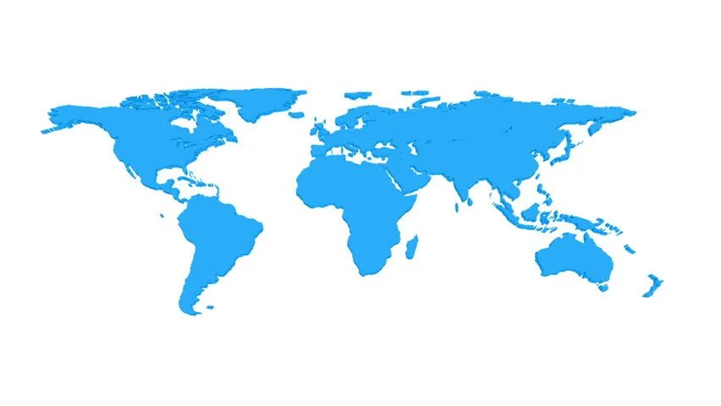
Fitting “Ford Motor Credit” into the High-Level View
Laws and regulations
Trade and commerce
Financial regulation
Securities regulation
Investor protection
Government enforcement (civil and criminal)
Private right of action (e.g., 1933 Act § 11)
Whom to sue ⬅ ⬅ ⬅
Why to sue ⬅ ⬅ ⬅
When to sue
Remedies

Slide 18
Appendix

Slide 19
U.S. Securitization Issuance Volume ($ trillions)
Mortgage Meltdown Starts
Dodd-Frank Act
Housing Bubble Starts
Financial Crisis Starts
Source: SIFMA

Slide 20
U.S. Non-mortgage Securitization Issuance Volume ($ billions)
Source: SIFMA

Slide 21
Additional Resources
The Mortgage Meltdown and the Failure of Investor Protection (2020)
The Deeper Causes of the Financial Crisis: Mortgages Alone Cannot Explain It (2013)
Handbook of Mortgage-Backed Securities (2016)
SIFMA MBS statistics
SIFMA ABS statistics
S&P-DOJ case: complaint (2013), order (2013), settlement (2015)

